Slide 1

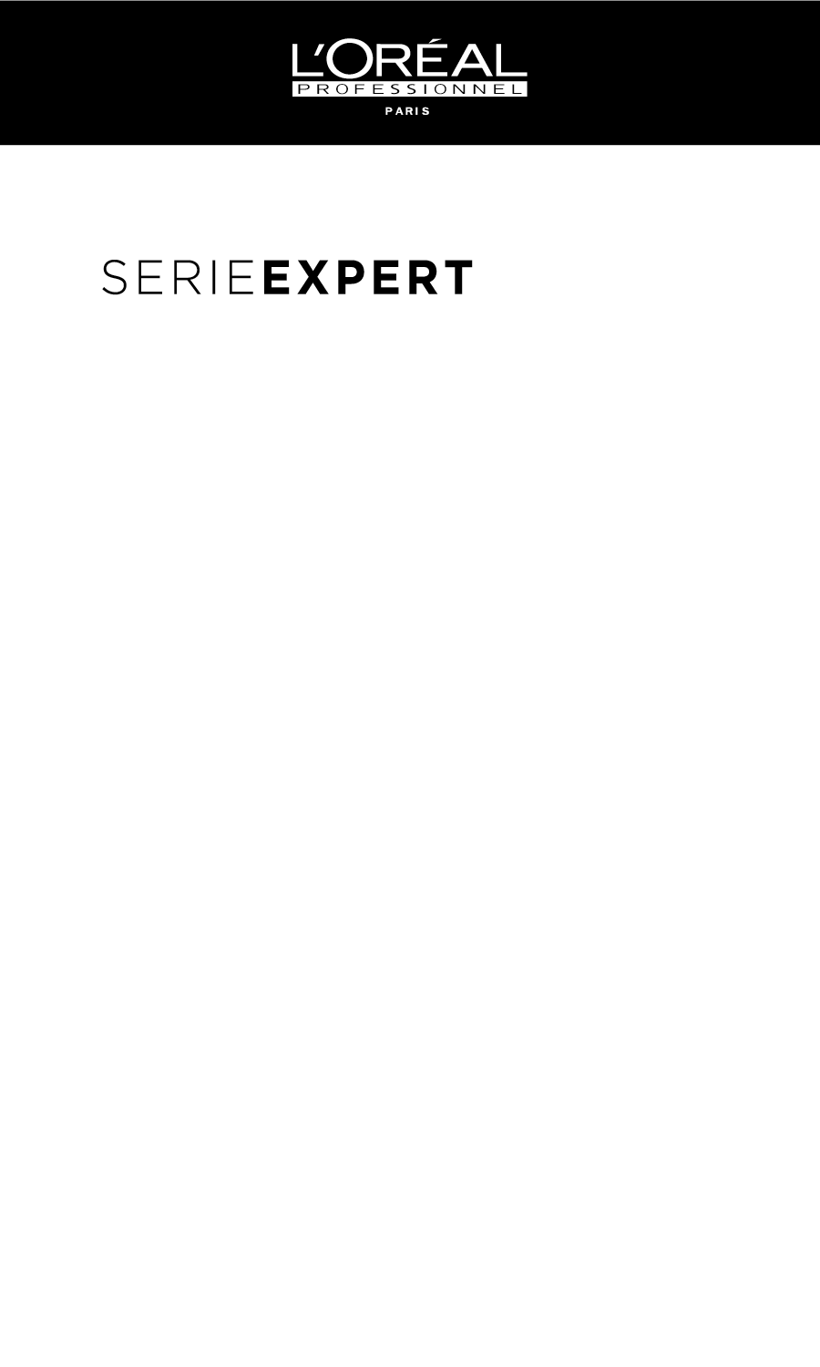
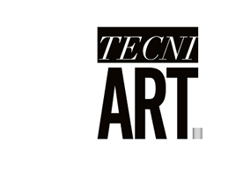
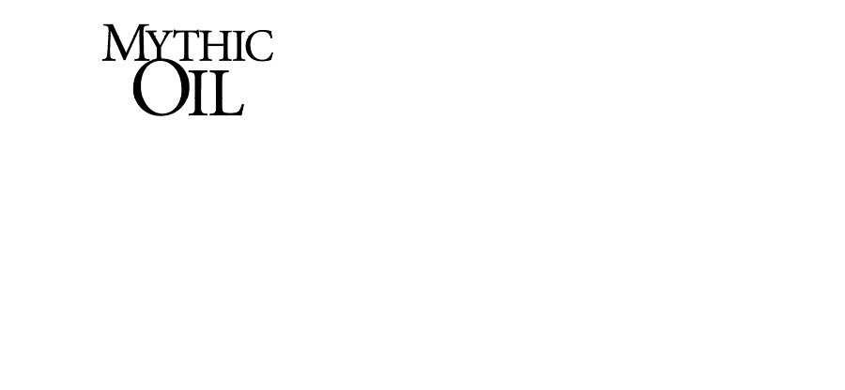
Metal Detox Shampoo $35.00
Metal Detox Mask $48.00
Shampoo 16.9 fl.oz $39.00
Conditioner 16.9 fl.oz $39.00
Mask 8.5 fl.oz $45.00
Leave-Ins $34.00
Super Dust $24.00
Fix Polish $24.00
All Other Stylers $30.00
Huile Originale $48.00
Crème Universelle $38.00

