Slide 1

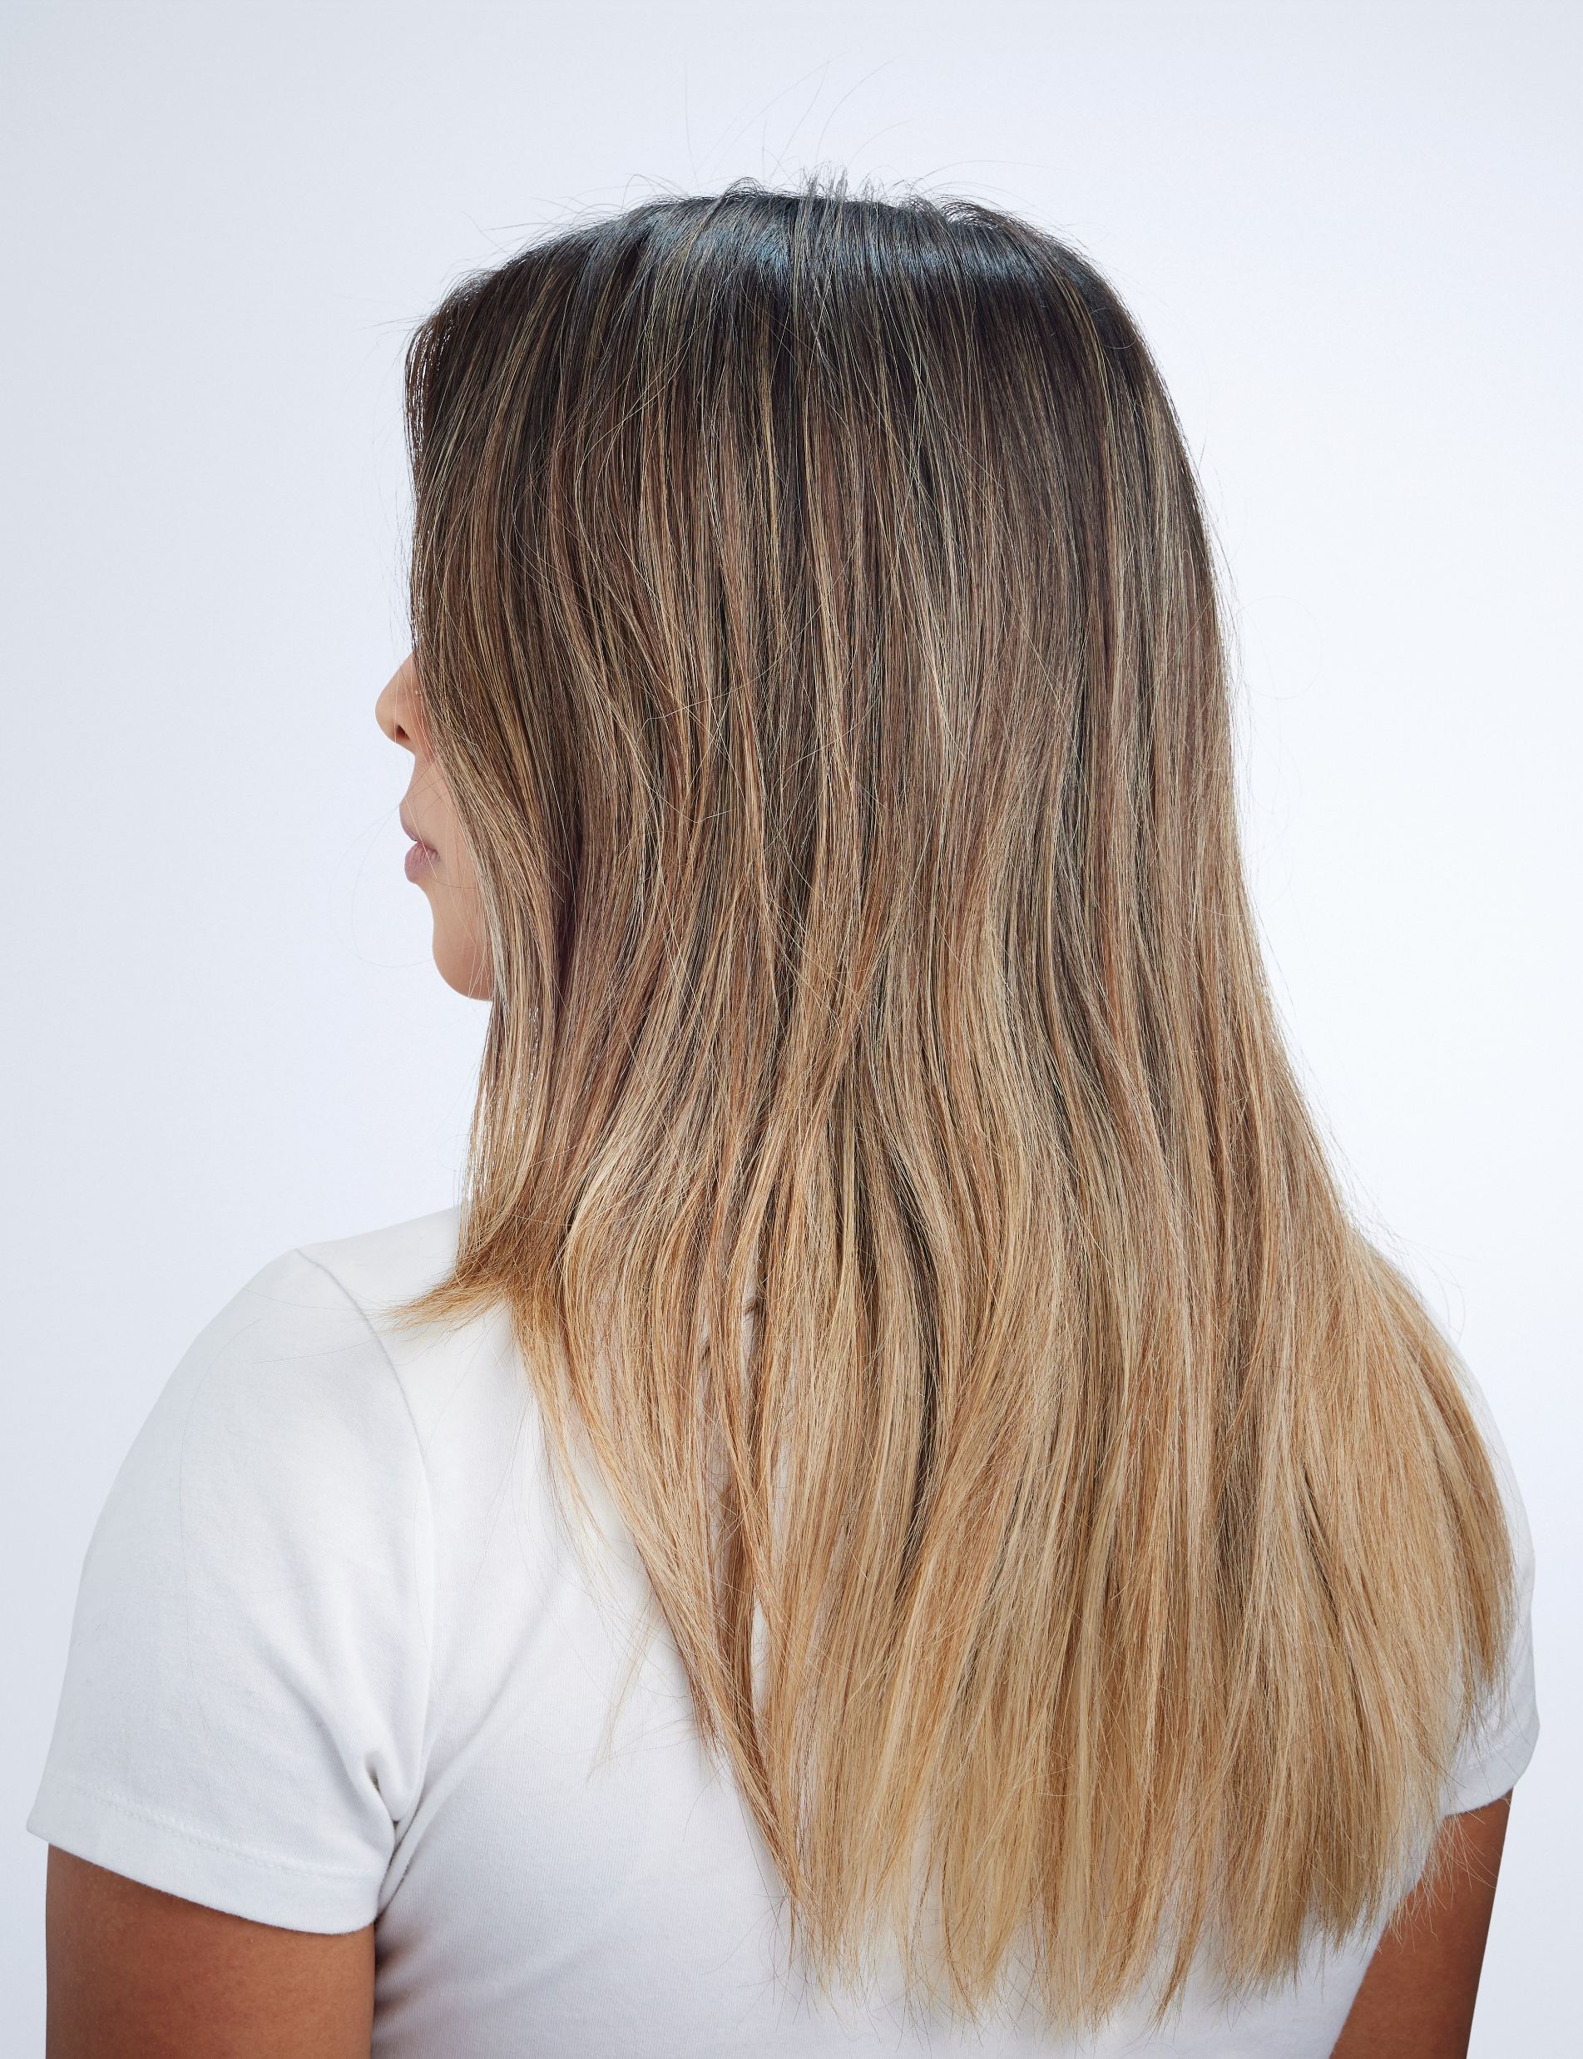
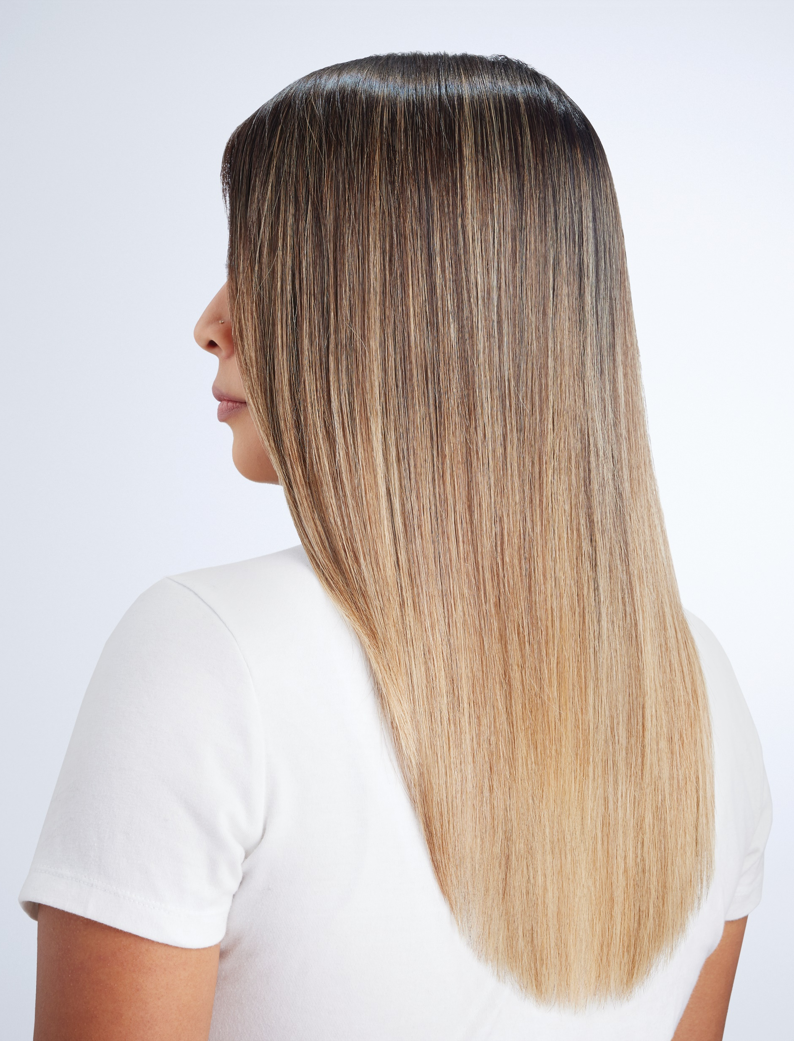
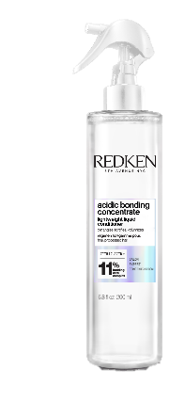
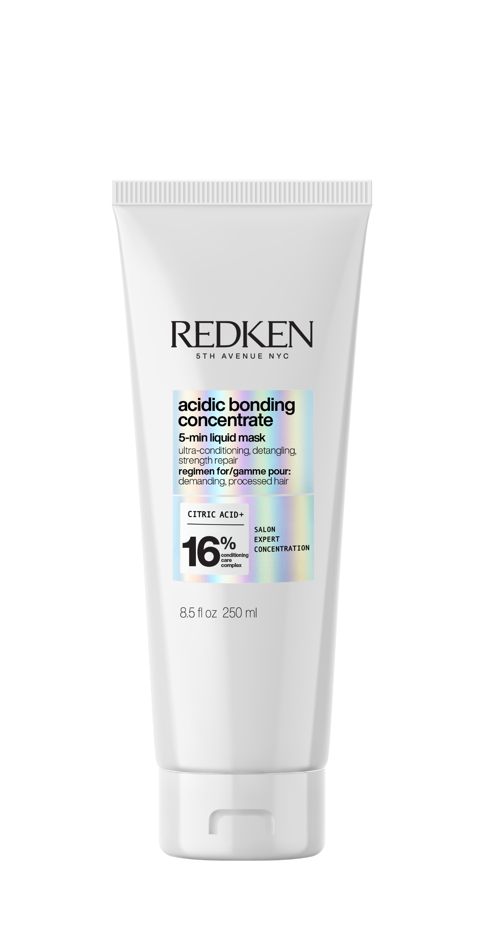
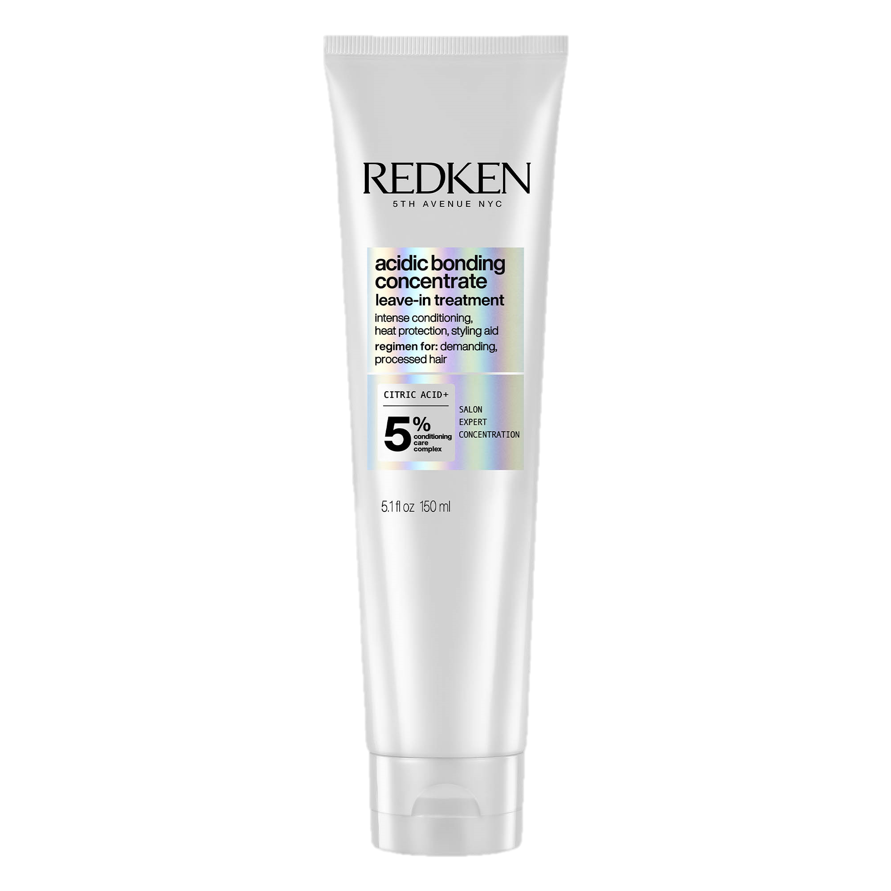
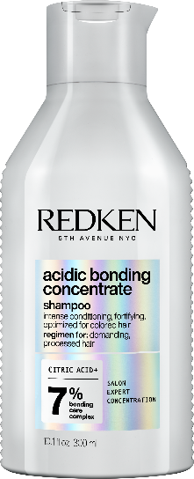
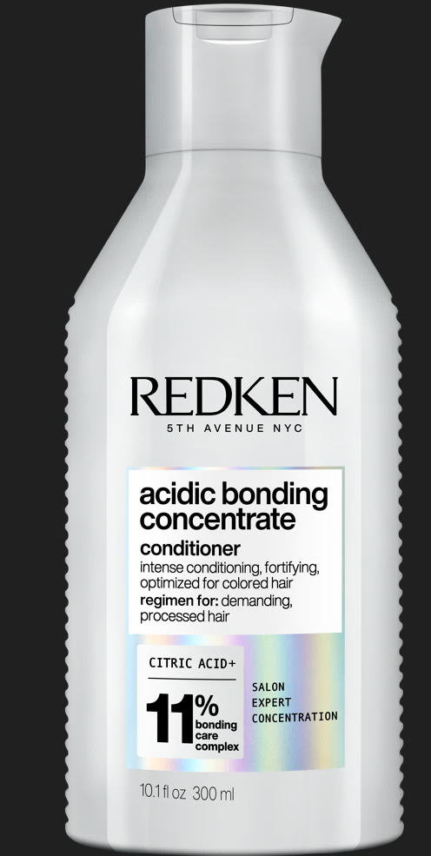
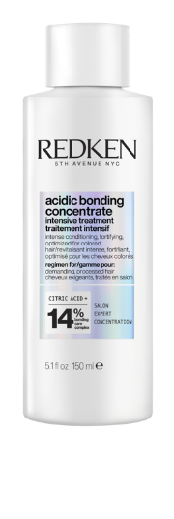
Acidic Bonding Concentrate
One use will change your hair
Claims
Combats 1 Year Of Visible Damage In 1 Use
Stronger Hair, Immediate Results
224M+ TikTok Views in 2024

Slide 2
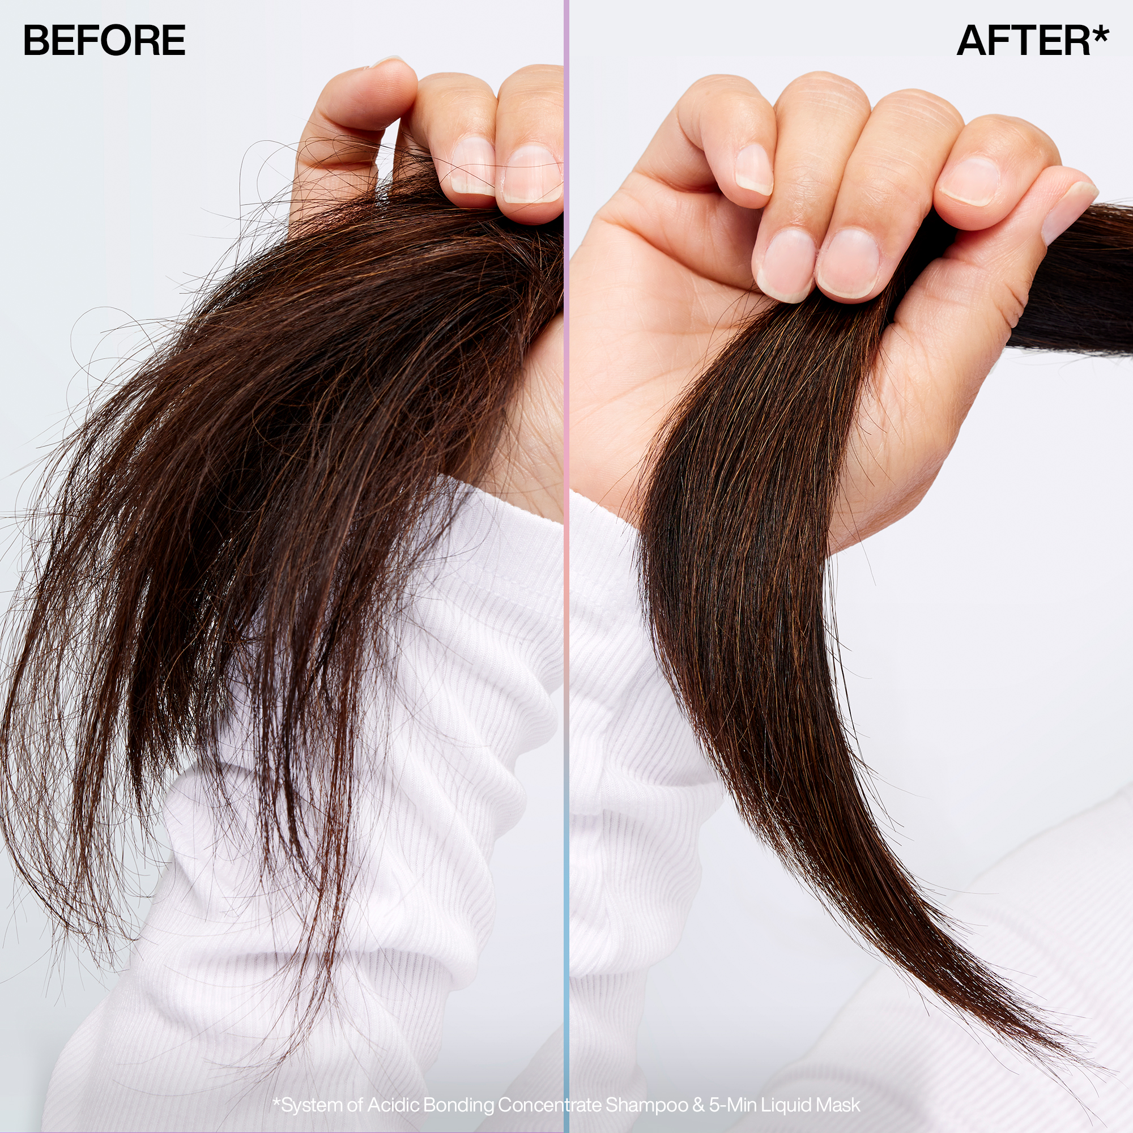
Acidic Bonding Concentrate 5-minute Mask
Deep Hydration, Deep Bond Repair
Claims
Intense Moisture & Strength In 1 Use
16% Conditioning Care Complex For 72 Hours Of Ultra Hydration
2x Shine For 3 Days
3x Stronger Inside & Out
14x Easier Detangling
Product Did Not Strip Hair Color
Suitable For Color-treated Hair
92M+ Views on TikTok

Slide 3
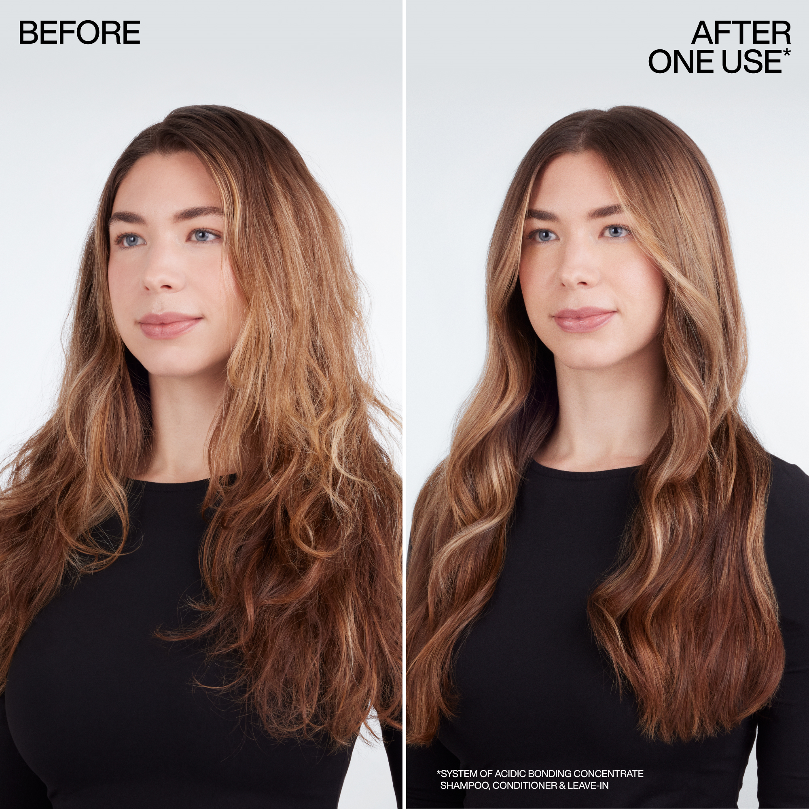
Acidic Bonding Concentrate Leave-in Treatment
Leave-in repair, Leave out damage
Claims
Strength Repair In 1 Use
Bond Repair On The Go
Heat Protection Up To 450F/230C
88% Visual Reduction In Split Ends
2x Less Breakage
10x Smoother
Product Did Not Strip Hair Color
Suitable For Color-treated Hair
104M+ Views on TikTok

Slide 4
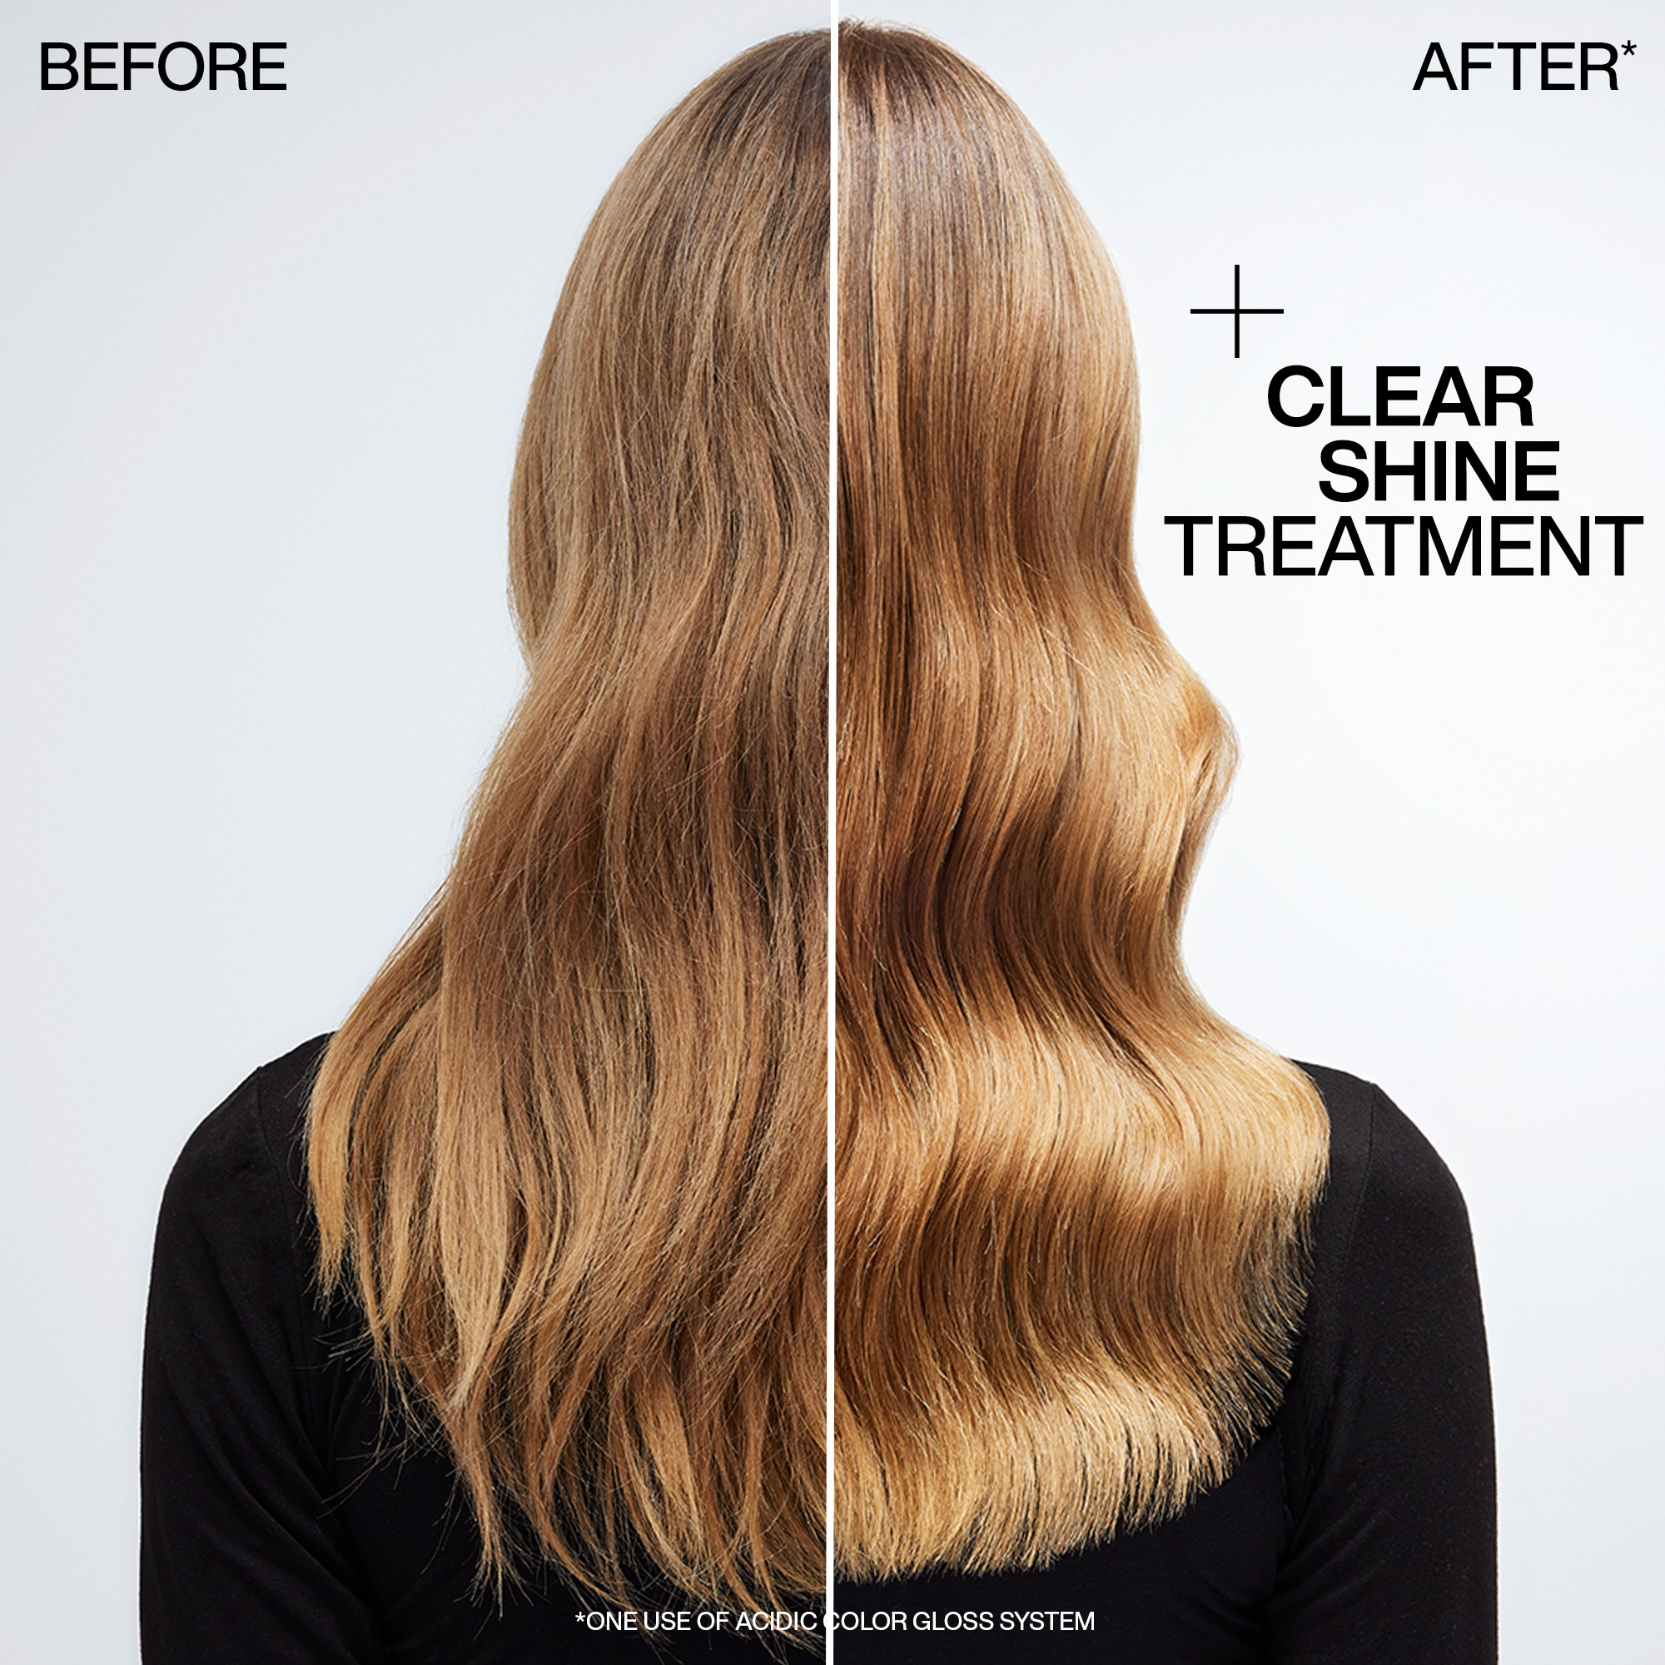
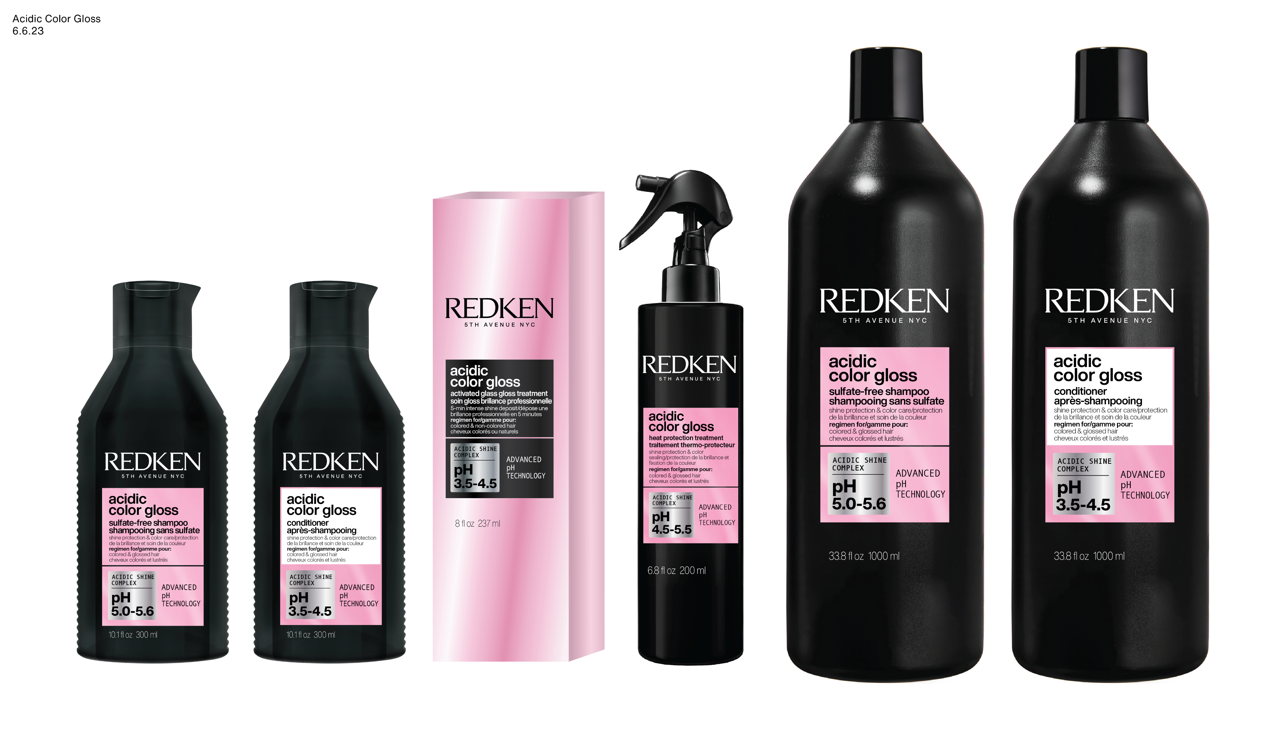
Acidic Color Gloss
Ignite your Shades EQ shine. / Your Shades EQ insurance. Salon-inspired glossing range for lasting color & revolutionary shine.
230M+ Views on TikTok
Claims
Color vibrancy for up to 32 washes*
2. Intense, molecular-level shine
+76% shinier hair**
Acidic pH formulas seal the cuticle & lock in shine

Slide 5
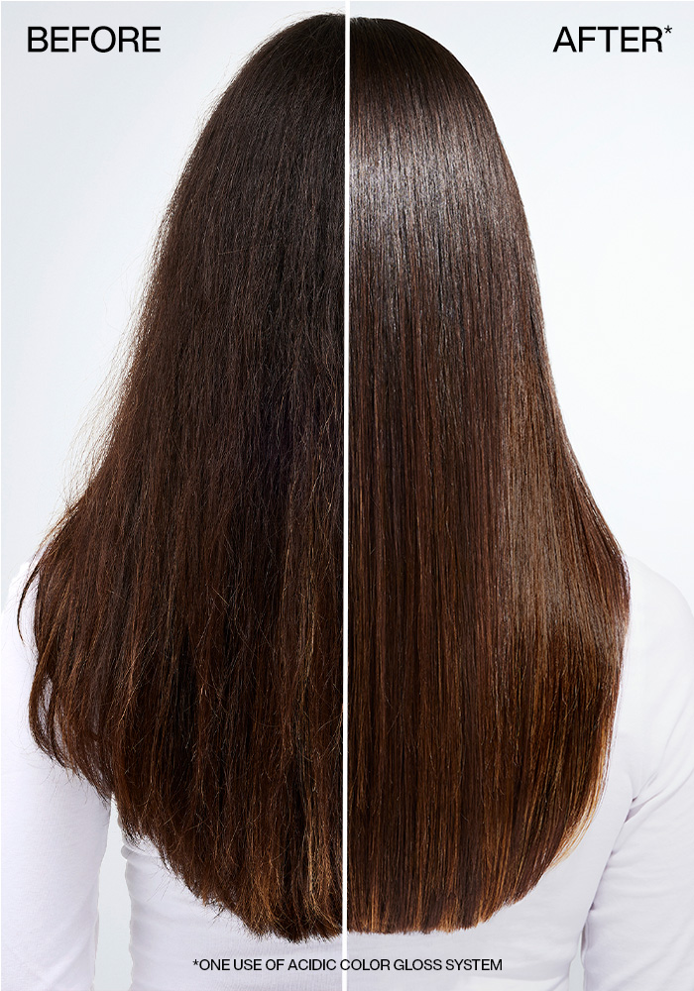
Acidic Color Gloss Heat Protection Treatment
Locks in color, shields out damage from heat, pollution, and minerals
113M+ Views on TikTok
Claims
90% Say Hair Feels Smooth
74% Say Hair Looks Sleek
90% Say Hair Is Easy To Style
Coats The Hair Without Covering Shine
Acidic Ph Formulas Seal The Cuticle & Lock In Shine
13x Smoother Hair/Easier To Detangle*
6x Hydration Boost*

Slide 6
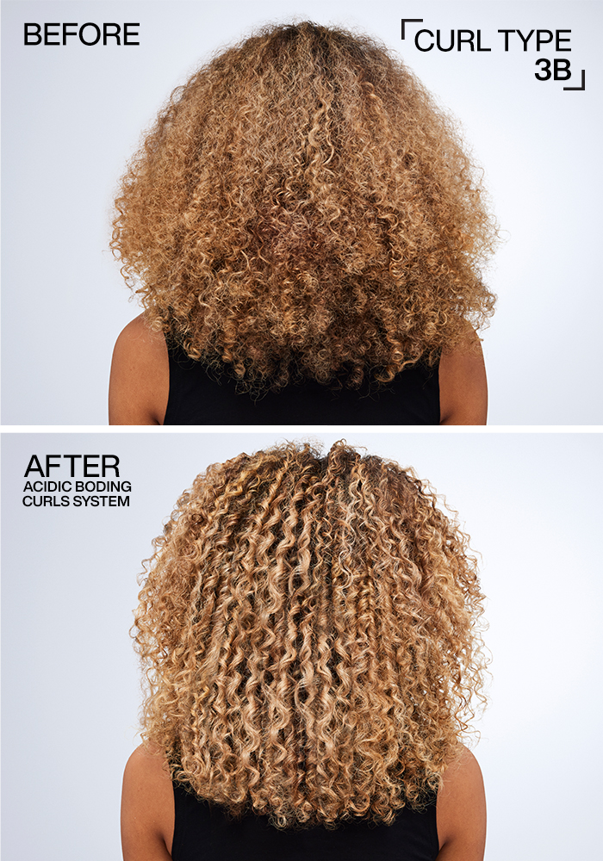
Acidic Bonding Curls
Repair curl strength. Restore curl pattern.
Claims
Silicone-free care bonding care to restore the pattern of curls & coils.
Build bonds + repair inner curl strength
92% saw healthier & more defined curls in 1 use
Silicone-free formulas hydrate + improve curl elasticity
56M+ Views on TikTok

