Slide 1
One Industry… Endless Opportunities

Slide 2
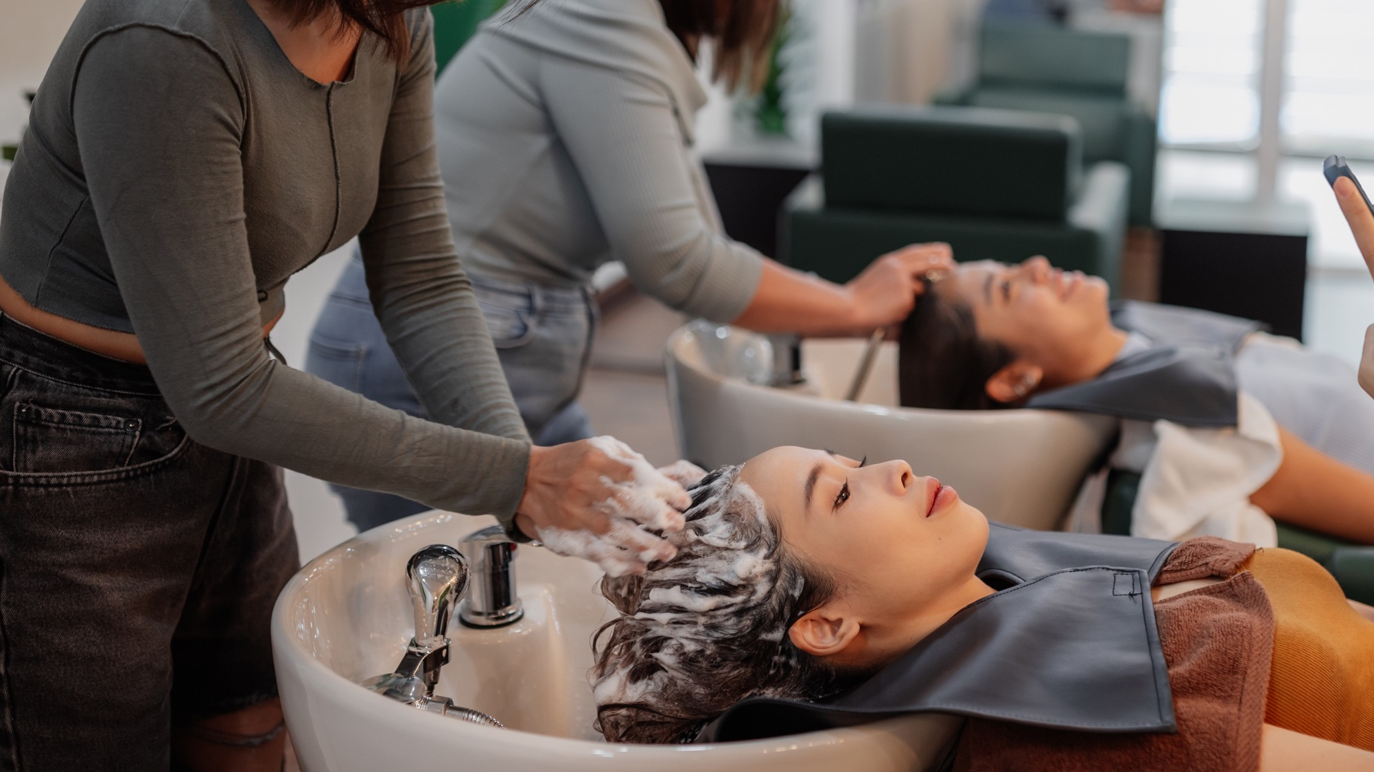
Our Mission
To inspire and empower the next generation of beauty professionals, driving increased enrollment and cultivating fulfilling, lifelong careers that shape the future of the beauty and wellness industry.

Slide 3
Student Statistics: Enrollment Data
150,000
148,000
+1.6% CAGR
140,000
137,000
130,000
120,000
2019
2024
Total Enrollment
# of Enrollments is Projected to Accelerate to a 5.4% CAGR Through 2030
Source(s): National Center for Education Statistics (NCES) IPEDS and National Student Clearinghouse (NSC) Research Center, fall enrollment projections are based on market projections divided by assumed growth in revenue-per-student based on historical trends, Validated Insights analysis.

Slide 4
Stylist Statistics: Retention Data
Less experienced stylists (2-5 years) have stabilized, but are still lower than 2019
More experienced stylists are on the rise, especially those working in commission salons
Source: US Stylist Incidence Report, 2024

Slide 5
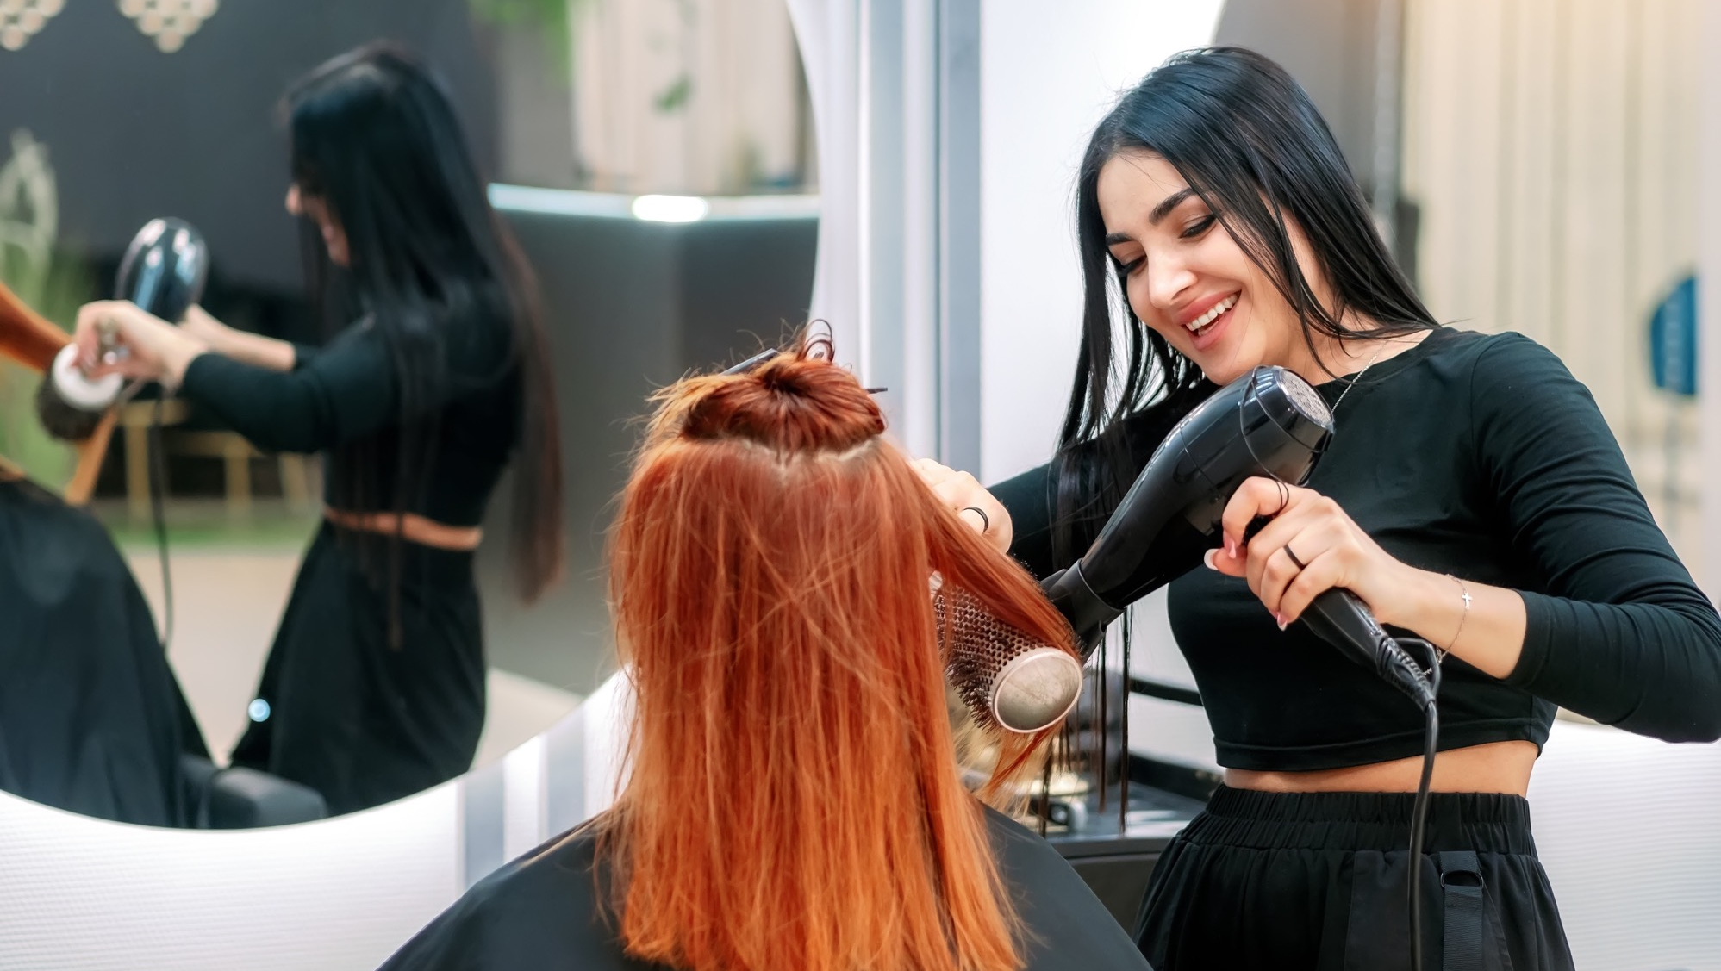




Our Objectives
Careers
Promote cosmetology as a viable, promising career with multiple pathways.
Money
Highlight the income potential and flexibility of
a career in cosmetology.
Diversity
Elevate the diversity of voices and backgrounds that shape the beauty industry.
Tools
Provide a recruitment & retention tool for our cosmetology school partners.
Notes:
My Beauty Story will promote cosmetology as a viable, promising career choice by highlighting multiple career opportunities and income potential available in the beauty & wellness industry
Showcase the benefits of attending a PPD school over competitive schools
Grow brand loyalty and build early PPD relationship with students to drive them to PPD salons and SlaonCentric / State RDA stores
Capitalize on students when they are most likely to engage with a brand
Highlight diverse backgrounds of industry professionals
Provide recruitment tool for PPD partner salons to promote a career in the beauty industry

Slide 6
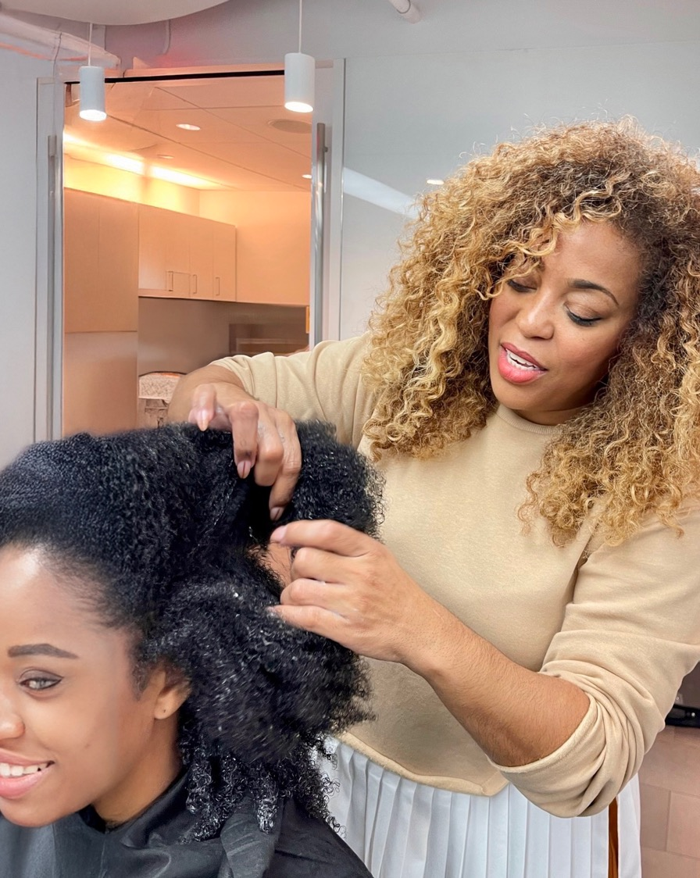
Deployment Strategy
Admissions Support
Ease concerns from prospective cosmetology students and parents about careers in the beauty industry.
Recruitment Events
Highlight the many career paths available to
cosmetology graduates.
High School Outreach
Equip guidance counselors to challenge the
perception of cosmetology as a “low-value” career.
Social Media
Share across industry platforms to support recruitment efforts of cosmetology school partners.
Distributor Use
Provide a helpful tool for distributor partners
to share at school events.
Notes:
Admissions process in Cosmetology Schools
Use in admissions meetings with potential students and their guardian/parent to ease trepidation about a career in the beauty industry
Career Fairs and Recruitment Events
Showcase at career fares and industry recruitment events to promote the diverse opportunities available to cosmetology grads
High School Guidance Counselors
Perception of cosmetology as a low value career choice with high school guidance counselors
Cosmetology School Social Media Platforms
Feature on cosmetology, school and industry platforms to support the recruitment strategies of our L’Oreal partner school companies

Slide 7
Notes:
[VIDEO]

